Slide 1
Logic And Computers
Gates and stuff

Slide 2
Objectives
Learn about some people who had a significant impact on computer operations
Develop a basic understanding of how binary numbers are represented and added in a computer
Learn about logic gates and truth tables.

Slide 3
Where it all started
George Boole
George Boole – 1850's
English Mathematician
Created algebra of logic now known as Boolean Algebra
Uses True or False
Claude Shannon
Claude Shannon 1930's
Applies Boolean algebra to electronic circuits
Binary digits can be represented by mechanical relays, vacuum tubes or transistors.
On
Off
Represented by binary numbers 0 and 1

Slide 4
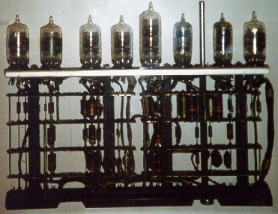
History of Computer Operations
An early byte 1950's:
http://mason.gmu.edu/~montecin/vacuum_tube.html

Slide 5
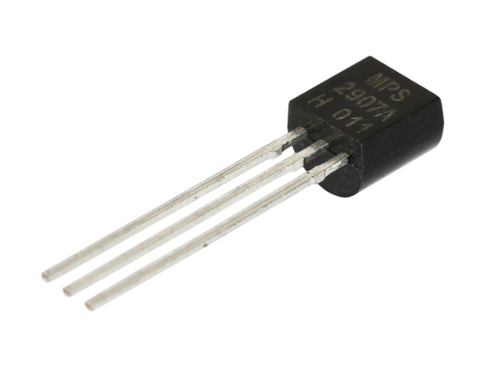
History of Computer Operations
Transistor – invented in 1947 Bell Labs
Replaced the vacuum tube
Acts as a switch or gate – can store a bit of 0 or 1
http://www.protostack.com/transistors

Slide 6
History of Computer Operations
Volatile
Need to temporarily store information such as 0's and 1's – done in RAM
Need to perform operations in processor
A bus is used to move bits from processor to RAM
Disappears when electricity is turned off
Non-Volatile
Need to store information more permanently
Hard drive
Flash Memory Devices – "Stick" or USB Drive
Uses different technology than RAM

Slide 7
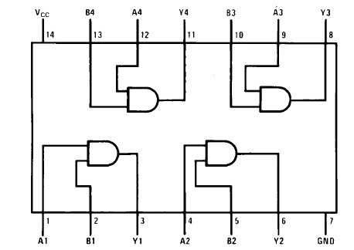

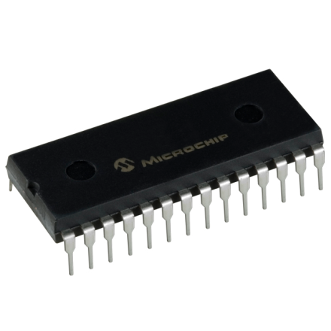
History of Computer Operations
Integrated Circuits
Operate according to Boolean algebra and consists of a series of gates
Modern computers can integrated circuits with millions of transistors
http://geekyginger.com/integrated-circuits-soul-of-your-you-device/
http://imgkid.com/integrated-circuit.shtml

Slide 8
Basics of Circuits
Computer circuits are made up of gates. Typically, there are three main types of gates
AND Gate
OR Gate
NOT Gate
In addition there are
NAND Gates
NOR Gates
XOR Gates

Slide 9

Basics of Circuits
AND Gate
Symbol
Truth Table for AND Gate
Lets Make One: http://www.neuroproductions.be/logic-lab/
INPUT A | INPUT B | OUTPUT AB
T | T | T
T | F | F
F | T | F
F | F | F
http://www.ee.surrey.ac.uk/Projects/CAL/digital-logic/gatesfunc/index.html#introduction

Slide 10

Basics of Circuits
EXOR Gate Exclusive OR
Symbol
Truth Table for AND Gate
Lets Make One: http://www.neuroproductions.be/logic-lab/
INPUT A | INPUT B | OUTPUT
T | T | F
T | F | T
F | T | T
F | F | F
http://www.ee.surrey.ac.uk/Projects/CAL/digital-logic/gatesfunc/index.html#introduction

Slide 11
Adding Binary Numbers
Rules:
0 + 0 =0
0 + 1 = 1
1 + 0 = 1
1 +1 = 10 the 1 is a carry
1 + 1 +1= 11 the first 1 is a carry
Remember in Base 10 when you add 9 + 1 you get 0 and carry the one
Same is true in binary. When you add 1 + 1 you get 0 and carry the one

Slide 12
Adding binary numbers
Ex:
00 01
01 01
01 10 here we carry the 1 to the 2's column
011
011
Here we carry a 1 to the 2's column and then add
1 + 1 +1 to get 1 and then carry a 1 to the 4's
column – check your answer by converting to
Base 10: 011₂ = 3₁₀ 3 + 3 =6 and 110₂ = 6₁₀

Slide 13
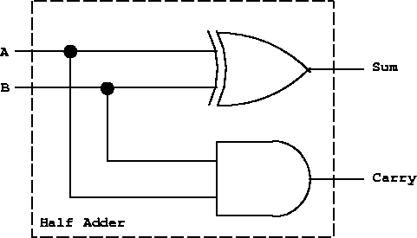
Adding Binary Numbers
Half Adder Circuit
A | B | Output XOR - SUM | Output AND - CARRY
0 | 0 | 0 | 0
0 | 1 | 1 | 0
1 | 0 | 1 | 0
1 | 1 | 0 | 1
Lets Make One: http://www.neuroproductions.be/logic-lab

Slide 14

Basics of Circuits
OR Gate
Symbol
Truth Table for AND Gate
Lets Make One: http://www.neuroproductions.be/logic
lab/
INPUT A | INPUT B | OUTPUT A+B
T | T | T
T | F | T
F | T | T
F | F | F
http://www.ee.surrey.ac.uk/Projects/CAL/digital-logic/gatesfunc/index.html#introduction

Slide 15

Basics of Circuits
Not Gate
Symbol
Truth Table for AND Gate
Lets Make One: http://www.neuroproductions.be/logic-lab/
INPUT A | OUTPUT
T | F
F | T
http://www.ee.surrey.ac.uk/Projects/CAL/digital-logic/gatesfunc/index.html#introduction

Slide 16

Basics of Circuits
NAND Gate
Symbol
Truth Table for AND Gate
Lets Make One: http://www.neuroproductions.be/logic-lab/
INPUT A | INPUT B | OUTPUT
T | T | F
T | F | T
F | T | T
F | F | T
http://www.ee.surrey.ac.uk/Projects/CAL/digital-logic/gatesfunc/index.html#introduction

Slide 17
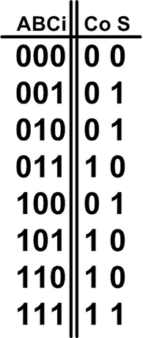
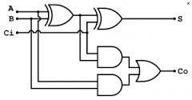
Basics of Circuits
Full Adder
This circuit has three inputs – one for a carry.
https://asicdigitaldesign.wordpress.com/2007/05/23/aclp-2-solution

Slide 18
Basics of Circuits
Typically a T = True and also would be represented by a 1
Typically a F = False and would be represented by a 0
Electricity:
T = 1 = Circuit is ON
F = 0 = Circuit is OFF
So, when solving a logic problem you want to think of a circuit being activated and turning on a light or bell as using a 1.
And, a circuit that has no electricity flowing would be a 0
So, you want to represent action or danger with a 1: Turning on a sensor or an alarm.

Slide 19
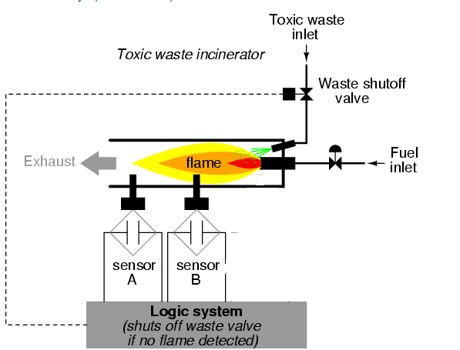
In Class Problem
Problem 1: Imagine a toxic waster incinerator.
Write a logic circuit and truth table with input A and Input B and Output Y where Y is 1 (produces signal and turns off waste inlet)only if both sensors show no flame.
Sensor A detects no flame and sends an electrical signal noted as a 1
Sensor B detects no flame and sends an electrical signal noted as 1
Adapted from http://www.allaboutcircuits.com/vol_4/chpt_7/9.html

Slide 20
In Class Problem
Answer
Big Truth Table
So, The AND gate would work. It produces a 1 (signal) only if both A and B are signaling (1's)activating the alarm.
See illustration : http://www.neuroproductions.be/logic-lab/index.php?id=35172
Input A | Input B | AND | XOR | OR | NAND | NOT
0 | 0 | 0 | 0 | 0 | 1 | If 0
0 | 1 | 0 | 1 | 1 | 1 | Then 1
1 | 0 | 0 | 1 | 1 | 1 | If 1
1 | 1 | 1 | 0 | 1 | 0 | Then 0

Slide 21
In Class Problem
Problem 2: Same toxic waste incinerator
Create a circuit and truth table so that the Output Y (turns off waste inlet)if either one of the sensors show the flame is off.
So flame off – danger - and sensor would activate and register a 1
And a 1 going to the alarm would activate it.
So, turn off if either sensor produces a 1 and also if both produce a 1
http://www.neuroproductions.be/logic-lab/index.php?id=35173
Input A | Input B | AND | XOR | OR | NAND | NOT
0 | 0 | 0 | 0 | 0 | 1 | If 0
0 | 1 | 0 | 1 | 1 | 1 | Then 1
1 | 0 | 0 | 1 | 1 | 1 | If 1
1 | 1 | 1 | 0 | 1 | 0 | Then 0

Slide 22
In Class Problem
Problem 3
Imagine there are two valves that pour a chemical into a vat. You never want to have both valves open at the same time. So if Valve A is open you want B closed and if Valve B is open you want Valve A closed. Draw a circuit with sensors and input that will have an output light that turns on and warns you if the system has failed. So, the alarm should go off if both valves are open.
So here you want either sensor to produce a 1 if its valve is open. And, if both sensors produce a 1 which means they are both open then the output of that is a 1 which turns on the light alarm. What if both valves are closed – then that is okay.
See next slide

Slide 23
Summary
So when solving a word problem it helps to state what your 0 and 1's represent.
Example: When a sensor detects a loss of flame it generates a 1( the electricity is turned on)
Typically a 1 is turning the electricity on or activating something like an alarm.
You could say well, the sensor doesn't read any flame so therefore a 0 signal is generated but I think that is confusing. Let's stay with activation of a sensor or alarm =1.

